Slide 1
Language Brief
LTC Andrew Kemp (48E)
FAO Proponent
HQDA DCS G-35 Strategy, Plans, and Policy
January 2024

Slide 2
Agenda
STANDARDS
PAY
SUSTAINEMNT TRAINING
CLANG MEMOS
POINTS OF CONTACT
Notes:
We’ll start with explaining what IRT is, and what it is not . . .
Then we’ll move into things to think about in preparation for IRT, In-region travel, and various requirements (JTR, GTCC, DTS, etc.).
IRT Regional Travel tips.
Points of contact.

Slide 3
STANDARDS
DLI/FLC GRADUATION STANDARD
- 2/2/1+ on the DLPT (will receive a failed to meet course standards AER if not achieved)
ARMY MINIMUM LINGUIST PROFICIENCY REQUREMENT
2/2 in any two modalities (Two skill OPI no longer accepted for FAOs)
a. The Army’s minimum linguist proficiency standard is level 2 (limited working proficiency) in any two modali-ties as delineated by the interagency language roundtable (ILR) for all linguists, USACAPOC Soldiers, and ARSOF Soldiers. (AR 11-6 Army Foreign Language Program, Chapter 2 Paragraph 5 – Proficiency Standards)
2/2 in any two modalities is not the goal, it is the minimum Army training standard that will allow you to check the box as language complete and not be in danger of being returned to your basic branch.

Slide 4
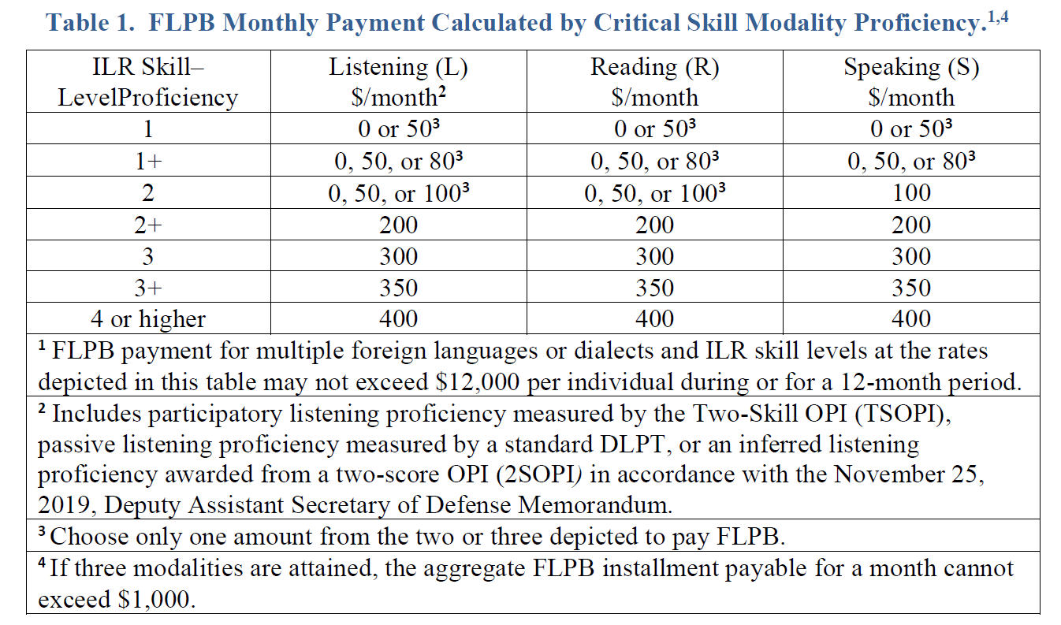
Foreign Language Proficiency Bonus (FLPB)
DOD INSTRUCTION 1340.27
MILITARY FOREIGN LANGUAGE SKILL PROFICIENCY BONUSES
Must be implemented NLT FEB 2023
If you assessed into FAO with a regionally appropriate language, you can get paid for it now.

Slide 5
LANGUAGE SUSTAINMENT TRAINING
… all language dependent and language capable enlisted Soldiers, warrant officers, and officers are required to complete 160 consecutive hours of foreign language training or equivalent annually in their CLANG (This will be reduced to 80 during the next revision)
Training in their CLANG is the priority for all language dependent and language capable Soldiers
Do not train additional languages until the Soldier completes their 160 hours of annual training (AT) in their CLANG and successfully passes their DLPT (for their CLANG).
(AR 11-6 Army Foreign Language Program, Chapter 3 Paragraph 2 – Unit Training: Command Language Programs)
Language Sustainment Programs are run by Command Language Program Managers (at the Army Service Component Commands for FAOs)
FAO Proponent fills the CLPM manager role for FAOs who do not fall under an Army Service Component Command

Slide 6
CLANG MEMOs
CONTROL LANGUAGE MEMORANDUMS (CLANG MEMOs) ASSIGN SOLDIERS THE LANGUAGES FOR WHICH THEY ARE AUTHORIZED TO DRAW FLPB PAY
IF YOU WANT TO KNOW MORE CHECK OUT THE FAO PROPONENT CLANG MEMO POLICY DATED 1 OCT 2022. (MILSUITE)
CLANG MEMOS DO NOT EXPIRE UNLESS THERE IS A SPECIFIC EXPARATION DATE WRITTEN INTO THEM (FOR INSTANCE FOR AN OUT OF AOC ASSIGNMENT)
CLANGs ARE DETERMINED BY FAO PROPONENT. IF YOU WANT TO REQUEST A PRIMARY CLANG CHANGE CONTACT ME.
IF YOU WANT TO ADD A LANGUAGE TO YOUR CLANG MEMO YOU MUST MEET THE FOLLOWING CRITERIA
Must be a language spoken in your region
You must be at least a 2/2 in your primary CLANG
You must be at least a 2/2 in the language you are trying to add as an additional CLANG

Slide 7
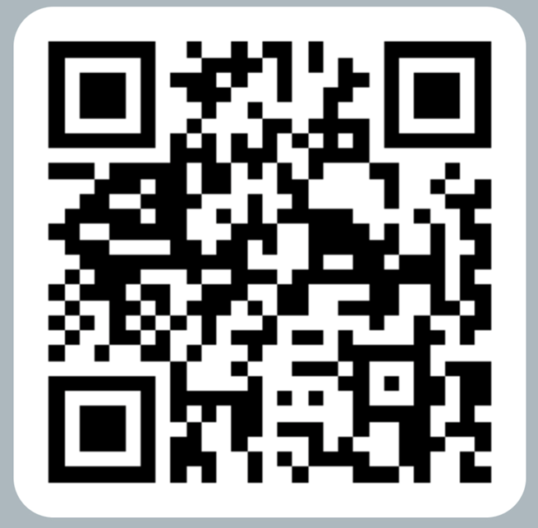
POINTS OF CONTACT
FAO PROPONENT LANGUAGE LEAD
LTC Andrew Kemp
Andrew.r.kemp.mil@army.mil
703-545-9018
HRC Incentives and Compensation Branch (For FLPB related issues)
- usarmy.knox.hrc.mbx.tagd-flpb@army.mil

