Slide 1
Spouse Zoom Meet & Greet

Slide 2
FAO Spouse Committee
Support with quarterly zoom calls, some with topics
Provide information for spouses (AFAOA Spouse Page)
For Army FAOs – The Army FAO Handbook – in draft
Meet & Greet – links to spouses who have previously lived in specific countries / assignments
Financially support annual spouse function in the NCR
Mentorship
Volunteer opportunities

Slide 3

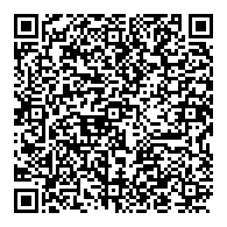


Join now!
Join the Army Foreign Area Officer Association (AFAOA)
http://www.armyfaoassociation.com/
$15.00 a year membership
The Military Order of Lafayette Honorary Society
Socials, Mentors, and more
Buy Army FAO
Merchandise
Bi-annual newsletter – Feburary 2025
Army Ten Miler – 12 October 2025
Annual Meeting and Awards Ceremony – 12 October 2025 – Washington DC
Annual Academic Journal – May 2025
Submit articles by 01 March 2025
Email: armyfaoassociation@gmail.com

Slide 4
Questions / Suggestions

